Slide 1
Rocks
Chapter
5
Learning outcomes: 1.2, 2.2

Slide 2
At the end of this chapter, you will be able to:
5.1 Describe the three different type of rocks and the rock cycle.
5.2 Explain how different rocks are formed.
5.3 Identify where different rock types are found in Ireland.
5.4 Describe and explain rock exploitation.
5.5 Describe the environmental, economic and social consequences of rock exploitation.

Slide 3
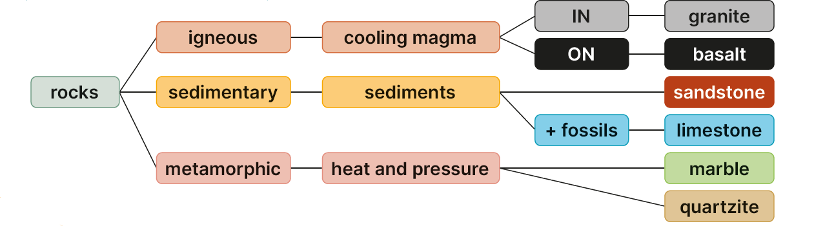
Keyword connections

Slide 4
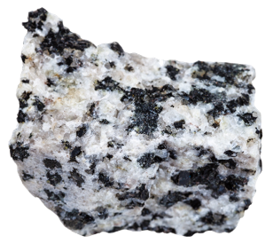
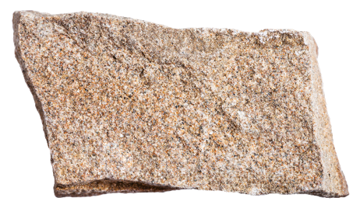
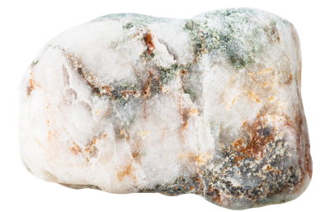
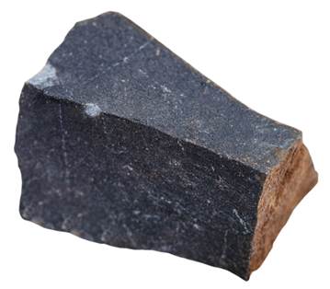
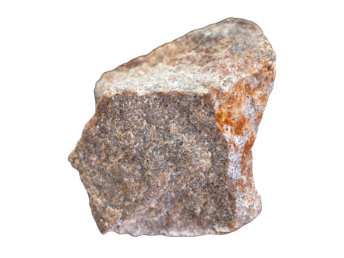
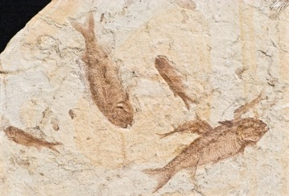
5.1 Describe the three different type of rocks and the rock cycle.
The crust of the Earth is made of solid rock. There are three types of rock.
Igneous rocks Sedimentary rocks Metamorphic rocks

Slide 5
5.1 Describe the three different type of rocks and the rock cycle.
Igneous | Sedimentary | Metamorphic
The first rocks to form were igneous. These rocks are formed when magma cools in the crust, or when lava cools on the Earth’s surface. The word ‘igneous’ means ‘born of fire’. | Weathering and erosion breaks down rocks into small fragments called ‘sediments’. Sediments are transported and deposited in seas or lakes. They are covered by other sediments and fossils. Compression turns the sediments into sedimentary rocks. | Heat from contact with molten magma and pressure caused by folding change the igneous and sedimentary rocks into metamorphic rocks. Sometimes plate movements cause rocks to melt back into the mantle.

Slide 6
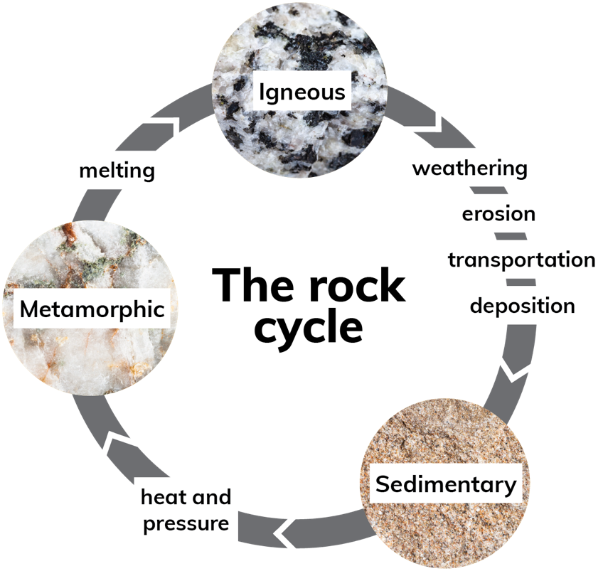
5.1 Describe the three different type of rocks and the rock cycle.

Slide 7
5.1 Describe the three different type of rocks and the rock cycle.
Go to Section 5.1 on page 16 of your Skills Book.

Slide 8
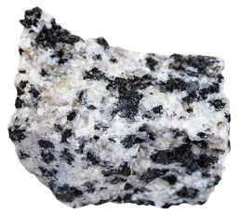
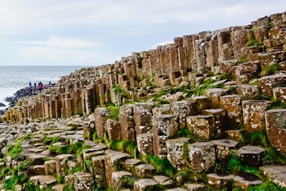
5.2 Explain how different rocks are formed – Igneous Rocks
Rock | Granite | Basalt
Sample
Formation | Magma cooled in Earth’s crust | Magma cooled on Earth’s surface
Crystals | Large Mica, feldspar and quartz | Very small Iron oxide
Texture | Rough | Smooth
Colour | Grey, speckled | Black, dark grey
Hardness | Hard | Very hard
Location | Wicklow Mountains | Giant’s Causeway, Co. Antrim
Rock | Granite | Basalt

Slide 9

5.1 and 5.2
1. Which rocks formed first on Earth?
2. How is granite formed?
3. What is granite composed of?
4. How is basalt formed?
5. What is basalt composed of?

Slide 10

5.1 and 5.2
Higher-order questions 1
1. What connections can you make between volcanic activity and igneous rocks?
2. What would happen if basalt cooled slowly?
3. What extra detail, if any, can you add to the rock cycle?

Slide 11

5.2 Explain how different rocks are formed – Sedimentary Rocks
Rock | Limestone | Sandstone
Sample
Formation | Sediments settled at bottom of seas and lakes, formed strata, compressed to form layers of rock | Layers of sand compressed and cemented together on the ocean floor
Texture | Smooth to rough | Smooth to rough
Colour | Pure white to grey | Yellow to red
Hardness | Soft, easily scratched | Harder than limestone
Location | The Burren, Co. Clare | Co. Cork and Co. Kerry

Slide 12

5.2 Explain how different rocks are formed – Sedimentary Rocks
1. What are sedimentary rocks?
2. How is limestone formed?
3. What is limestone composed of?
4. How is sandstone formed?
5. What is sandstone composed of?

Slide 13
5.2 Explain how different rocks are formed – Sedimentary Rocks
Higher-order questions 2
1. Are rock strata such as those in Figure 5.5 (page 44) always horizontal?
2. Why are fossils sometimes found high up in the Alps?
3. Where did all the sand gather before it became thick layers of sandstone?

Slide 14


5.2 Explain how different rocks are formed – Metamorphic Rocks
Rock | Marble | Quartzite
Sample
Formation | Great heat from magma- baked limestone | Great heat from magma-baked sandstone
Texture | Smooth, cold to touch | Smooth to rough
Colour | White to black with veins of red, green, red, yellow and white | White-grey sparkly
Hardness | Hard | Very hard
Location | Green marble (due to minerals) is found in Connemara | Great Sugarloaf Mountain, Co. Wicklow

Slide 15

5.2 Explain how different rocks are formed – Metamorphic Rocks
1. What two processes form metamorphic rock?
2. How is marble formed?
3. What is marble composed of?
4. How is quartzite formed?
5. What is quartzite composed of?

Slide 16
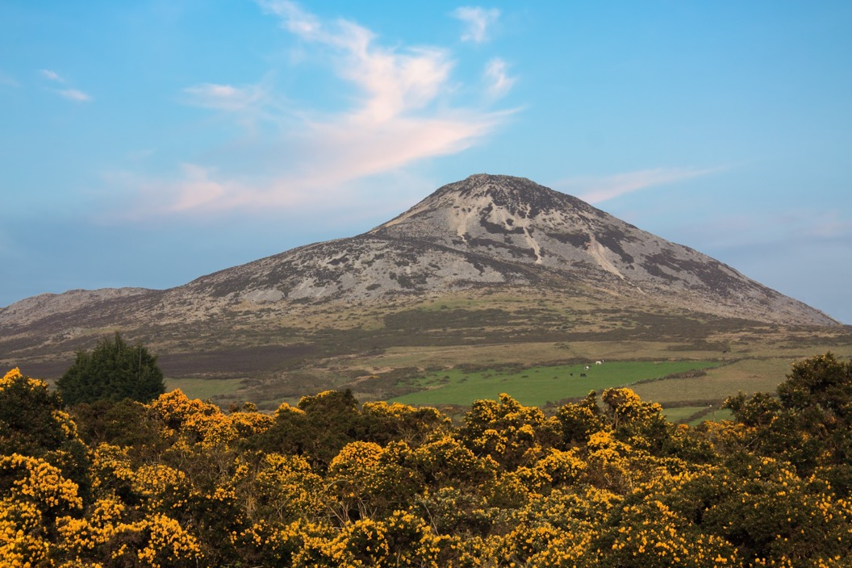
5.2 Explain how different rocks are formed – Metamorphic Rocks
Higher-order questions 3
1. Where does the magma come from that changes rocks into metamorphic rocks?
2. What would marble look like if there were no other minerals involved when it formed?
3. In the photograph, why does the Sugarloaf appear above the surrounding landscape?

Slide 17
5.2 Explain how different rocks are formed – Metamorphic Rocks
Go to Section 5.2 on page 17 of your Skills Book.

Slide 18
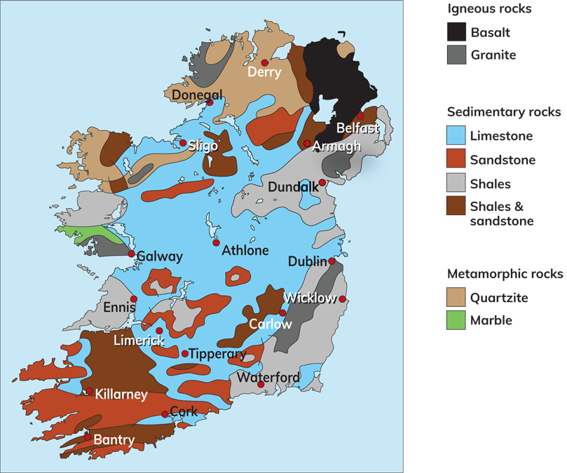
5.3 Identify where different rock types are found in Ireland.
Go to Section 5.3 on page 17 of your Skills Book.

Slide 19
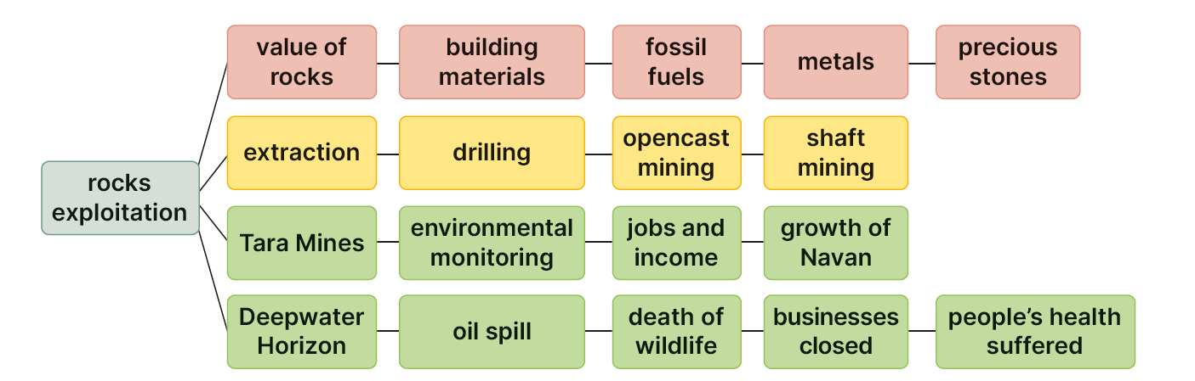
5.4 Describe and explain rock exploitation.
Keyword connections

Slide 20
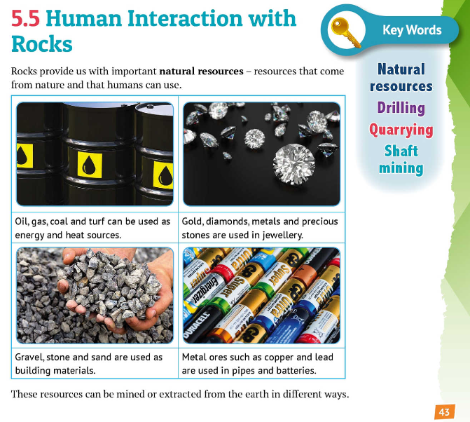

Slide 21
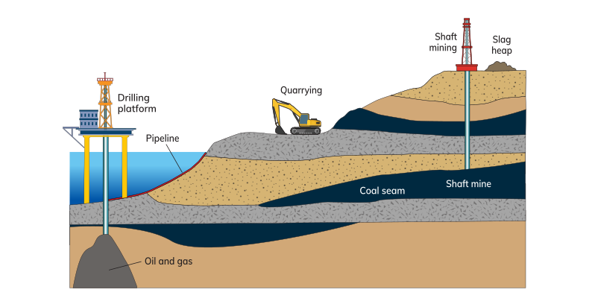
5.4 Describe and explain rock exploitation.
Extraction of rocks

Slide 22
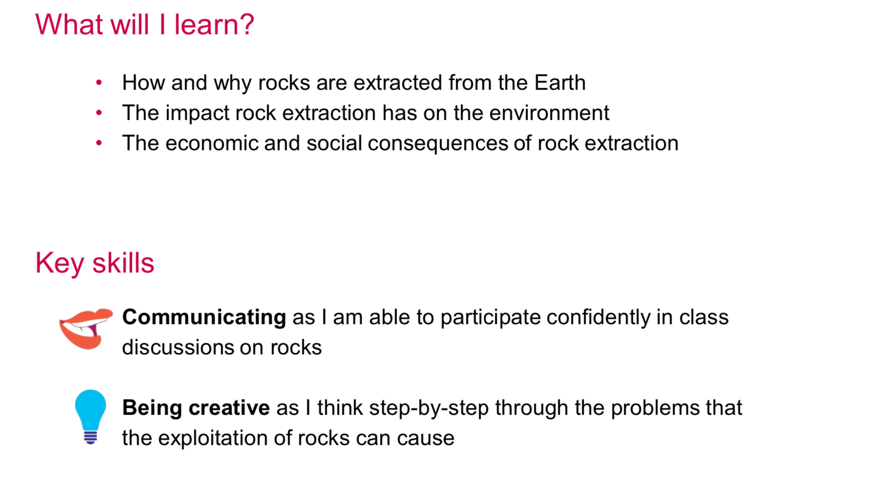
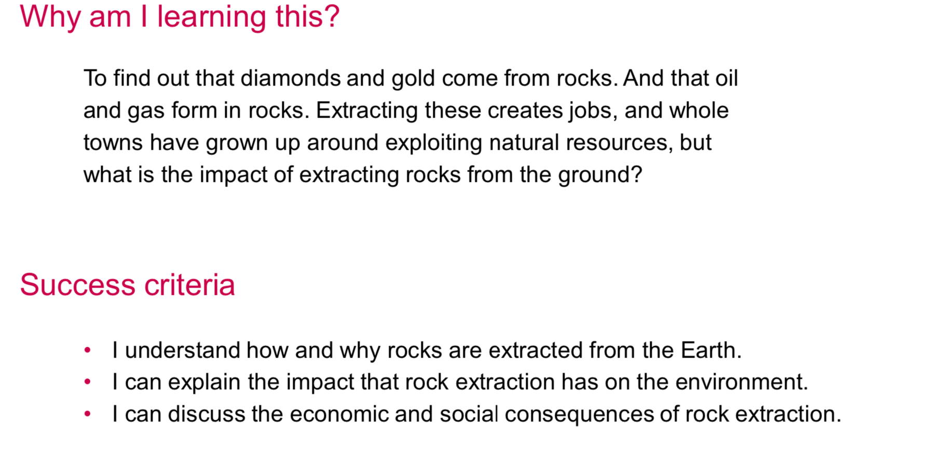

Slide 23
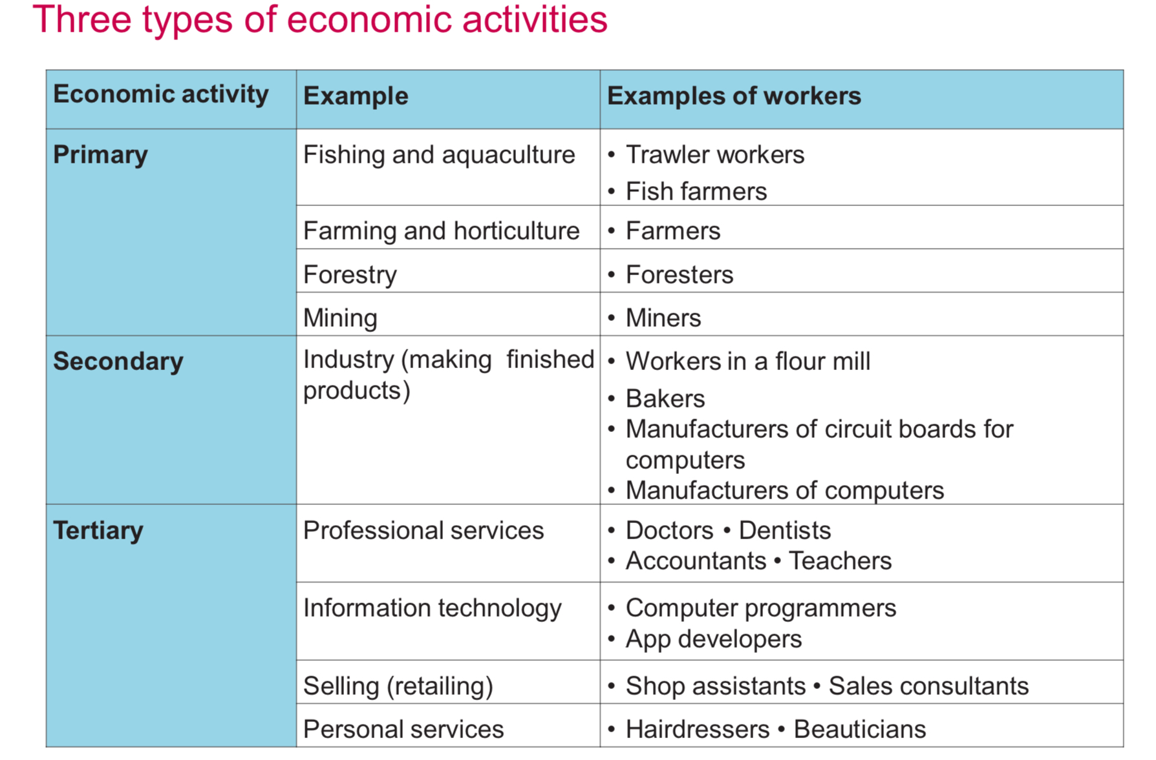

Slide 24
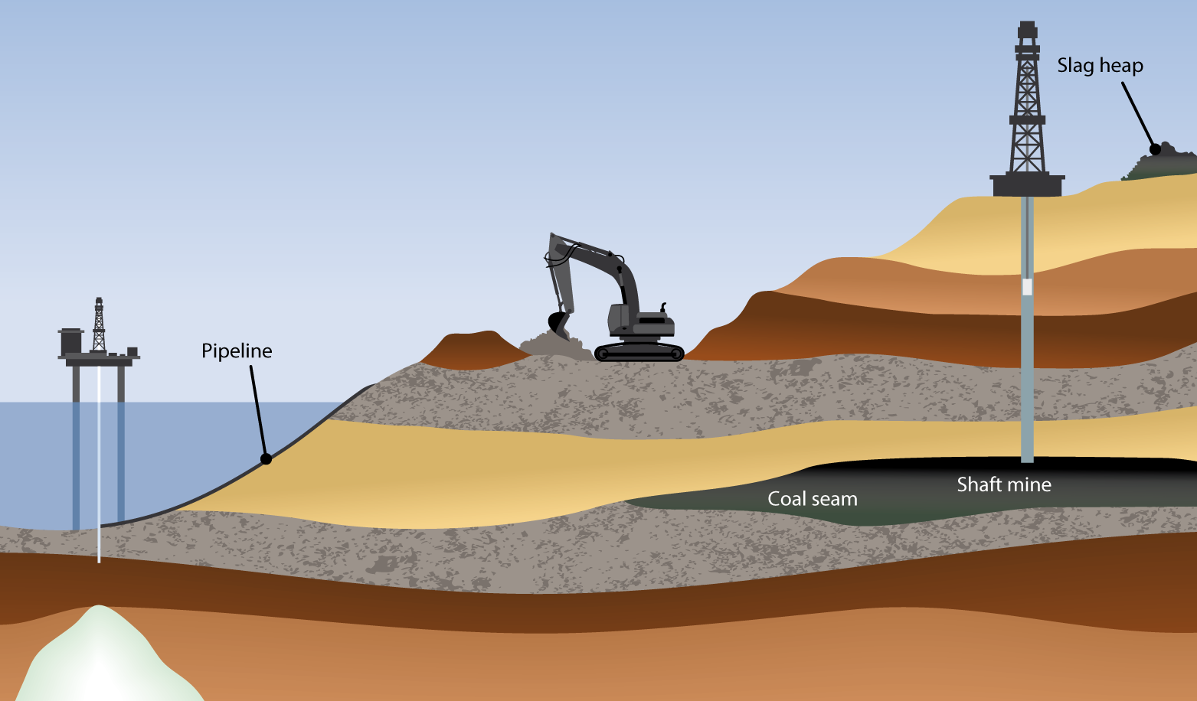
Extraction of rocks
Drilling is the process of boring down into the earth’s crust to extract oil or gas. This can happen on land or out at sea. Oil and gas are used as fuel sources in cars, homes and industry.
Quarrying is the process of removing rock, sand, gravel or minerals from the ground. Quarrying happens at or near the surface of the earth. The materials extracted are used by the construction industry to build roads and buildings.
Shaft mining is the process of drilling vertically into the earth to gain access to minerals beneath the surface. Coal, lead and zinc can be accessed in this way and brought to the surface.

Slide 25
5.4 Describe and explain rock exploitation.
Extraction of rocks
1. Drilling
Oil and gas are extracted from underground reservoirs by drilling.
If oil or gas is found under the sea, drilling takes place from an offshore platform or rig.
The oil or gas is then pumped ashore through a pipeline. This is called offshore drilling
Example: Corrib Gas Field.
2. Opencast mining/quarrying
If a resource is on or near the surface of the Earth, opencast mining is used to extract it.
This is the cheapest form of mining, but it is very noisy and dusty, and can scar the landscape.
Quarrying is used to extract stone, gravel and sand for use in the construction industry.
3. Shaft mining
This is used if a resource is lying in seams deep in the Earth.
Shafts are constructed to reach the seams.
It is a very expensive and dangerous, and can spoil the landscape.
Shaft mining is used to extract coal and metal ores.
For example: Lead and zinc ores are extracted from the Tara Mines in Navan, Co. Meath.

Slide 26
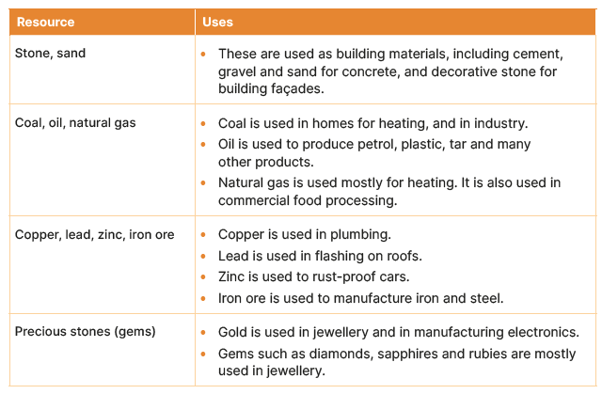
5.4 Describe and explain rock exploitation.
The value of rocks

Slide 27

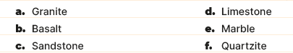
5.4 Describe and explain rock exploitation.
Name one location in Ireland where each of the following rocks are found:
2. Name the three types of mining.
3. Identify three resources we get from rock.
4. Why is drilling for oil and gas becoming unpopular?
5. What do copper, lead, zinc and iron ore have in common?

Slide 28
5.4 Describe and explain rock exploitation.
Higher-order questions 4
1. Look at the list of the values of rocks on page 48 of your Textbook. What other uses of rock resources can you think of?
2. What happens to a shaft mine after all the rock resource has been extracted?
3. Investigate the term ‘fracking’. Find out what it is and what resources are involved.

Slide 29
5.4 Describe and explain rock exploitation.
Go to Section 5.4 on page 18 of your Skills Book.

Slide 30

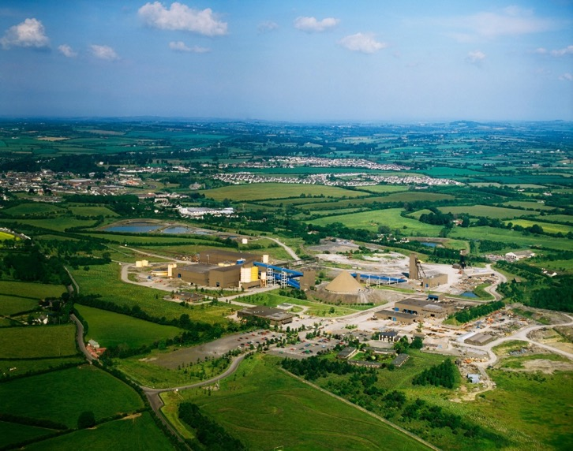
5.5 Describe the environmental, economic and social consequences of rock exploitation.
Tara Mines, Co. Meath
1. Swedish mining group Boliden
2. Navan in Co. Meath, 1970
3. Largest zinc mine in Europe
4. Zinc: medicine, rust-proofing
5. Lead: construction
6. Each year, two million tonnes of zinc and lead concentrate are exported through Dublin Port to manufacturing plants in Finland and Norway.

Slide 31
5.5 Describe the environmental, economic and social consequences of rock exploitation.
Tara Mines, Co. Meath
Environmental
Tailings
Visual impact
Economic
Direct employment
Indirect employment
Development of Navan
Social
Facilities improved, e.g. road and rail
Navan developed
Increased population

Slide 32
5.5 Describe the environmental, economic and social consequences of rock exploitation.
Tara Mines and sustainability
Boliden aims reduce the impact of mining on the environment.
Waste rock is mixed with cement and returned to the mine.
Waste water is purified before being recycled.
Boliden aims to reduce its CO₂ emissions by 40 per cent by 2030.
Boliden aims to preserve biodiversity at their mining sites by:
Avoiding impacts on biodiversity
Minimising impacts that do occur
Restoring the environment after mining activity
Boliden has a project to plant 2.6 km of hedgerows.
It also recycles sewage sludge from local authorities for use as fertiliser.
It works with universities to improve how it reclaims land that has been mined.

Slide 33
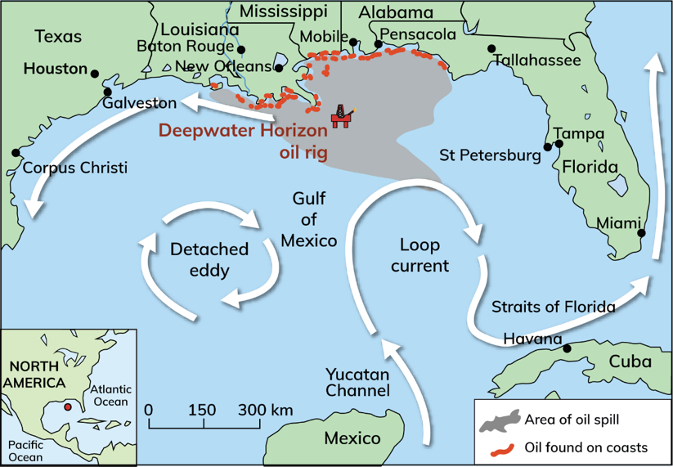
5.5 Describe the environmental, economic and social consequences of rock exploitation.
Deepwater Horizon
April 2010
Deepwater Horizon oil rig
Gulf of Mexico, Louisiana coast, USA
Blow-out occurred
Gas escaped from an oil well and caught ﬁre.
171 million gallons of oil leaked into the Gulf over 87 days.
The oil rig sank to the ocean ﬂoor 5,000 feet below.

Slide 34
5.5 Describe the environmental, economic and social consequences of rock exploitation.
Deepwater Horizon
Environmental
Coastline contaminated
Reduced catches of shrimp and oyster
Animals killed by the oil
Coral extensively damaged
Economic
Financial loss of $11.6 billion
$8.7 billion impact on fishing
Tourism industry suffered
Social
Eleven workers killed
Seventeen more injured
Health of workers affected by oil and smoke
Job losses, migration

Slide 35
5.5 Describe the environmental, economic and social consequences of rock exploitation.
Deepwater Horizon: Long-term implications and sustainability
The oil spill covered an area over twice the size of Ireland.
Some of the oil was burned off the surface.
This released toxins into the air.
Some oil was collected (skimmed) from the ocean surface.
However, the use of 1.8 million gallons of dispersant to make the oil sink made this task more difficult.
A report on the oil spill recommended:
Improving oil-rig safety
Safeguarding the environment
Improving the response to oil spills
Decreasing the likelihood of oil spills from similar accidents in future.

Slide 36
5.5 Describe the environmental, economic and social consequences of rock exploitation.
Go to Section 5.5 on page 19 of your Skills Book.

Slide 37
Assess your progress
Go to page 20 of your Skills Book and assess your progress.
5.1 Describe the three different type of rocks and the rock cycle.
5.2 Explain how different rocks are formed.
5.3 Identify where different rock types are found in Ireland.
5.4 Describe and explain rock exploitation.
5.5 Describe the environmental, economic and social consequences of rock exploitation.
Identify any gaps in your learning. Use the Rapid Revision on page 53 of your Textbook to jog your memory.

